Slide 1
Pacman
2 of 3

Slide 2
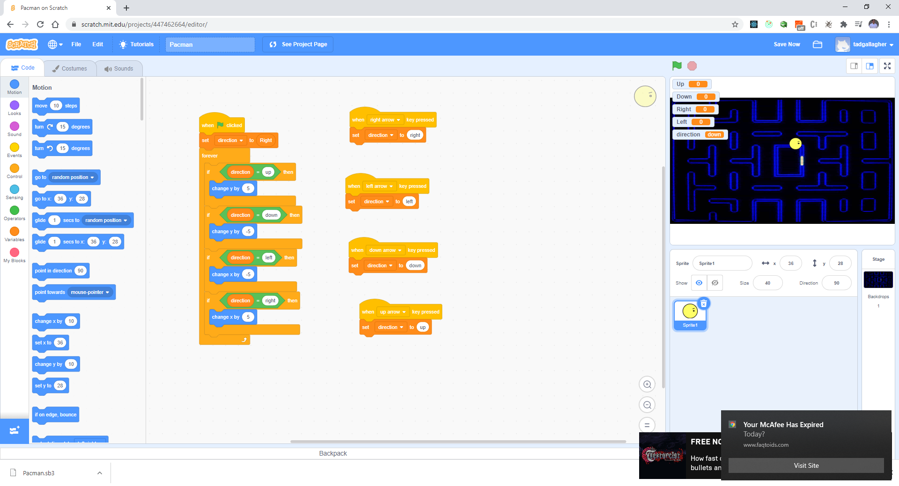
Make the following changes

Slide 3
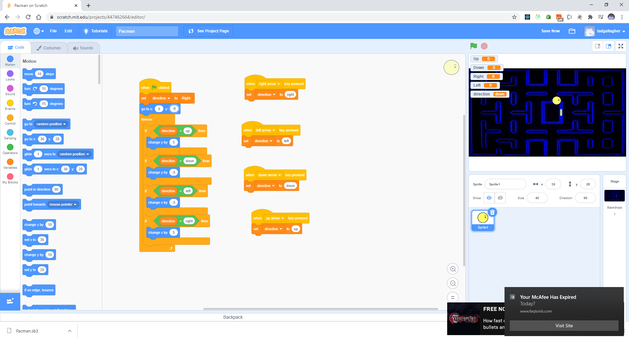
Start in Center

Slide 4
Test your work
Press Up, Down, Left, and Right

Slide 5
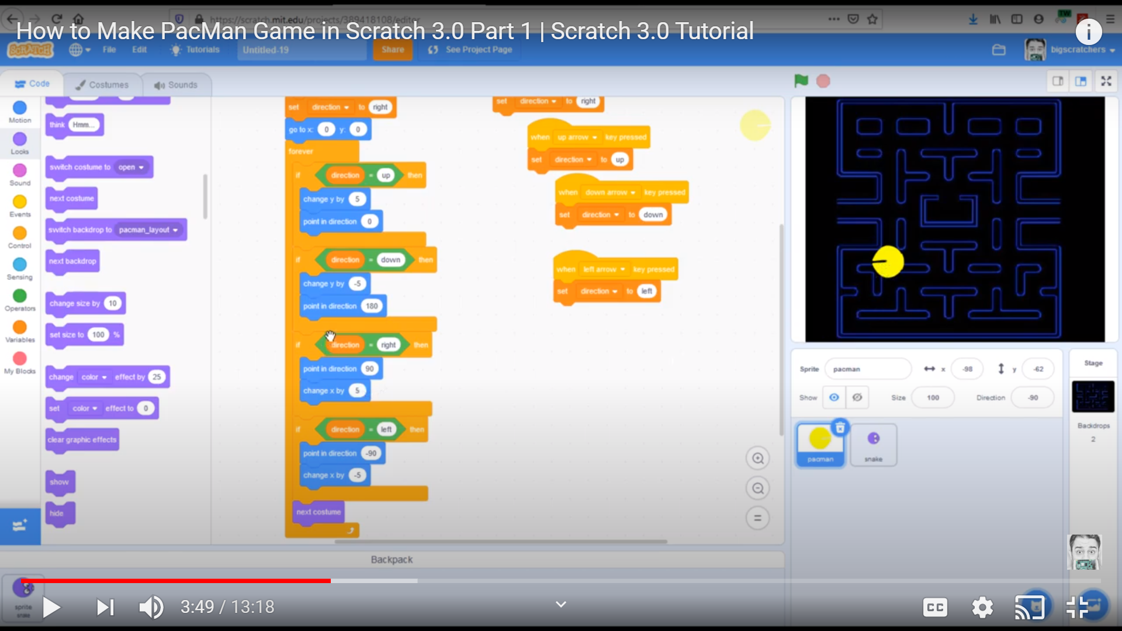
Add a next Costume

Slide 6
Test your work
What happens?

Slide 7
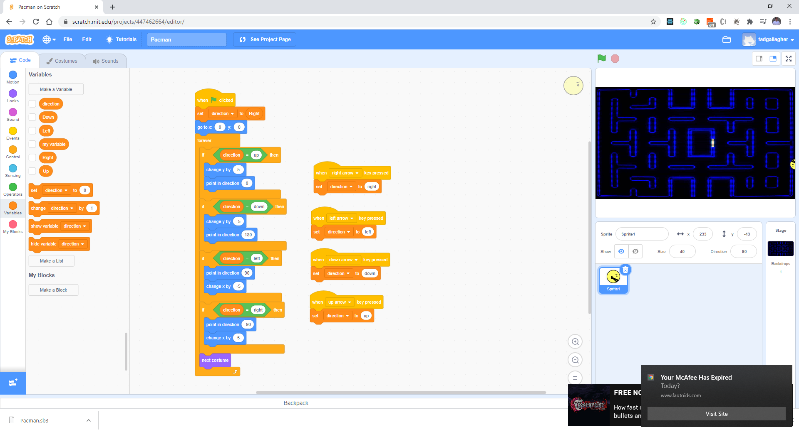
Hide your variables

Slide 8
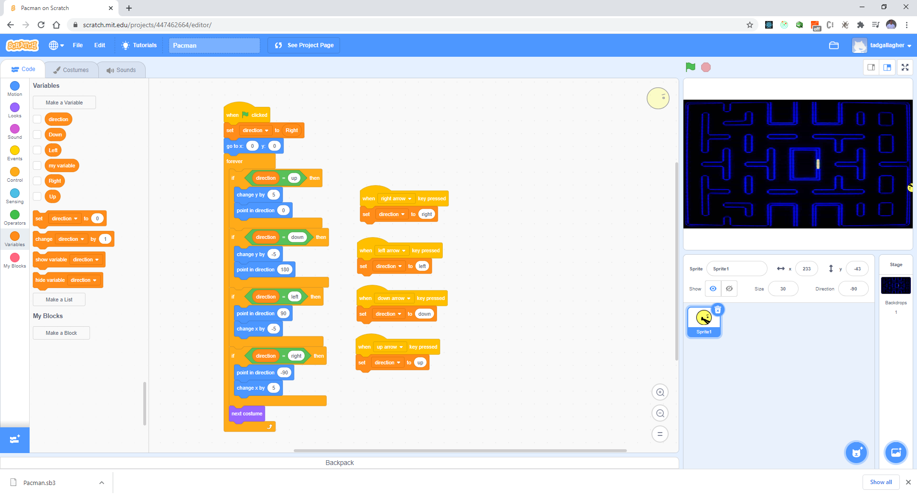
Resize your Pacman

Slide 9
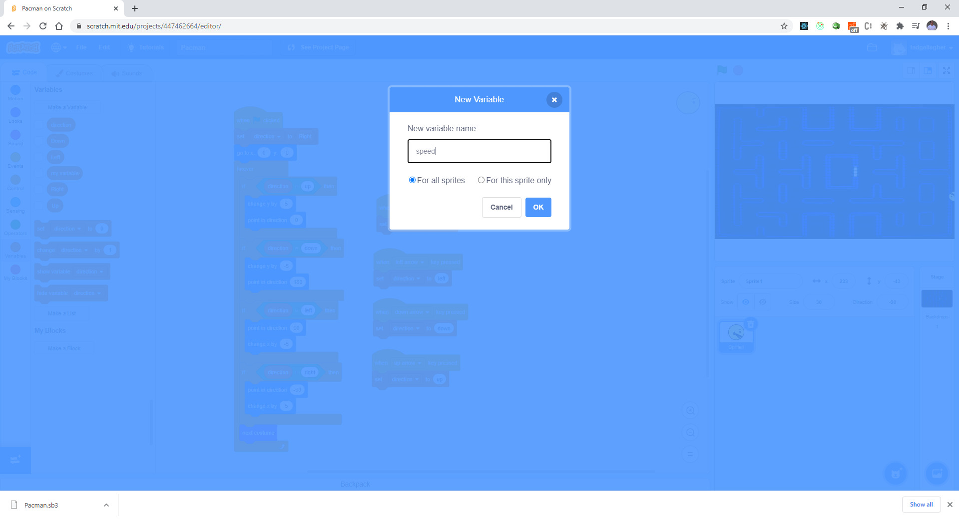
Lets slow down the speed

Slide 10

Make a negative Speed also

Slide 11
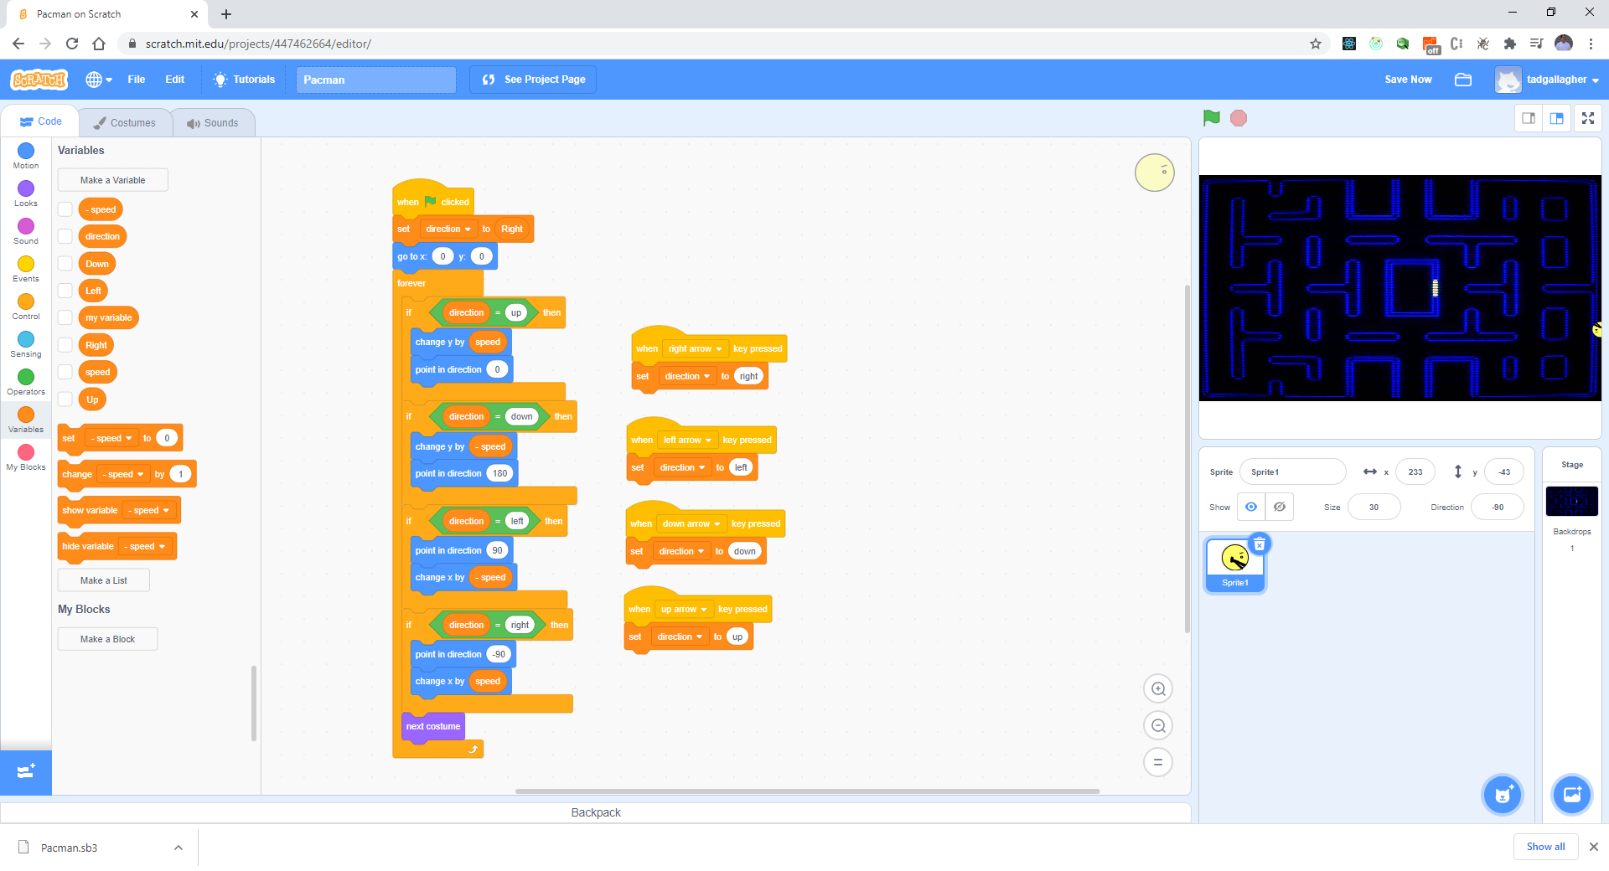
Update with variables – 4 places

Slide 12
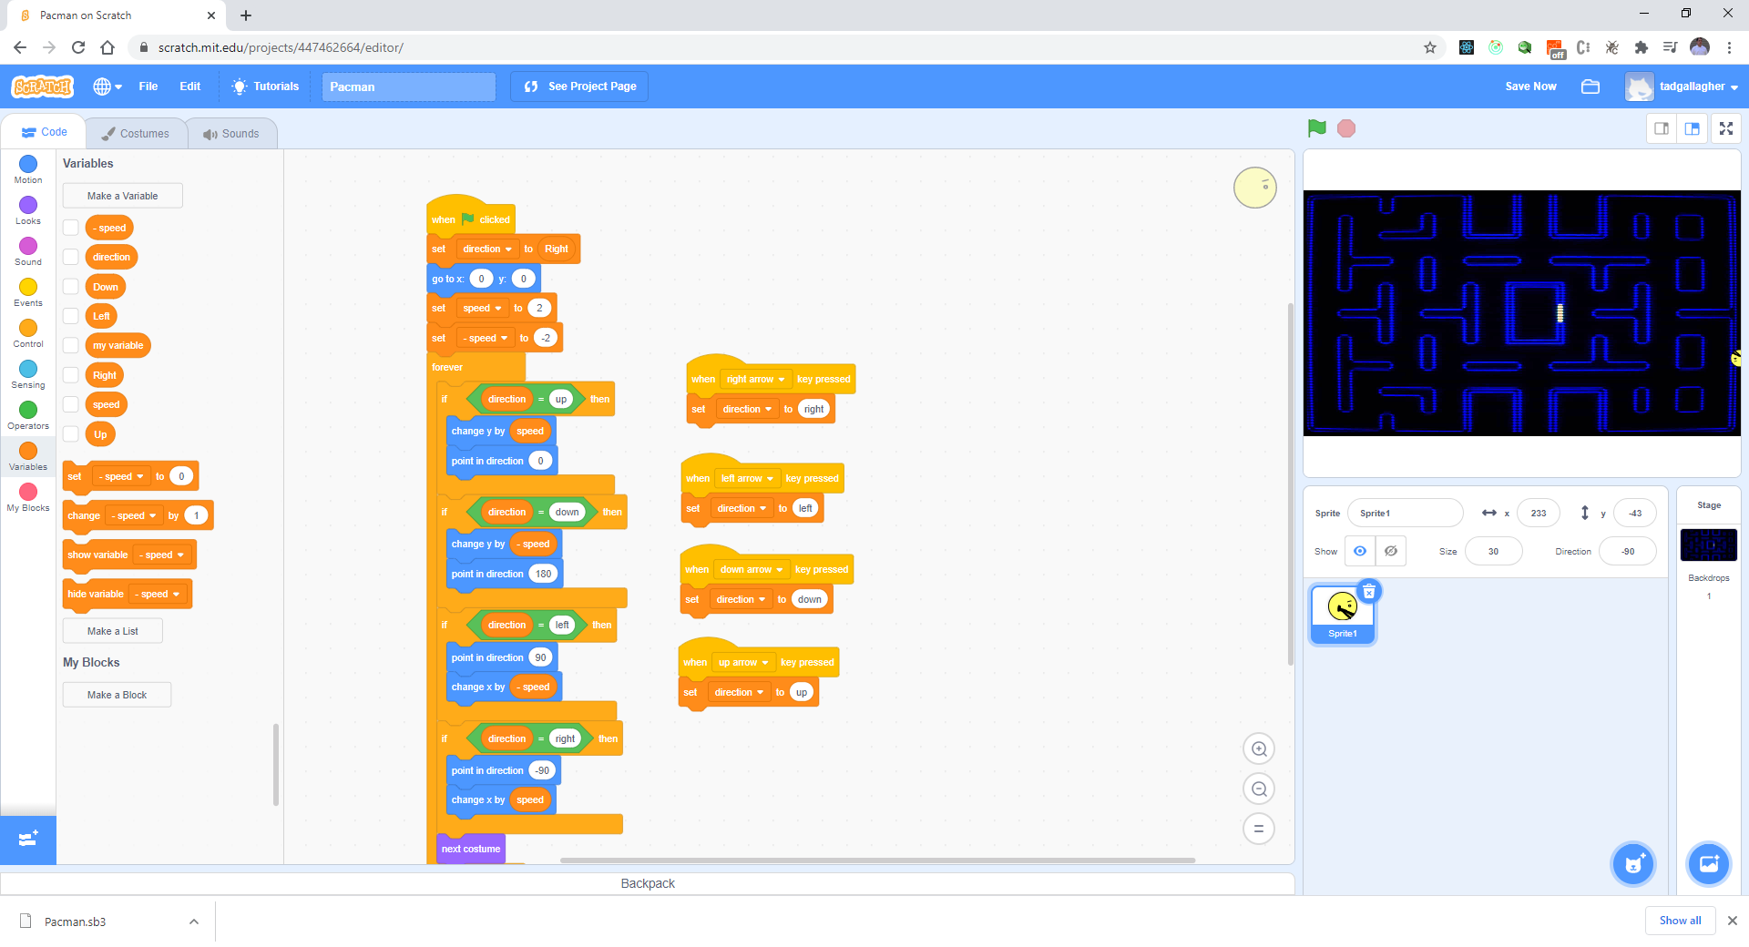
Initialize Speed

Slide 13
Test your work
Is the speed better?

Slide 14

Next we want the character to stop on blue walls

Slide 15
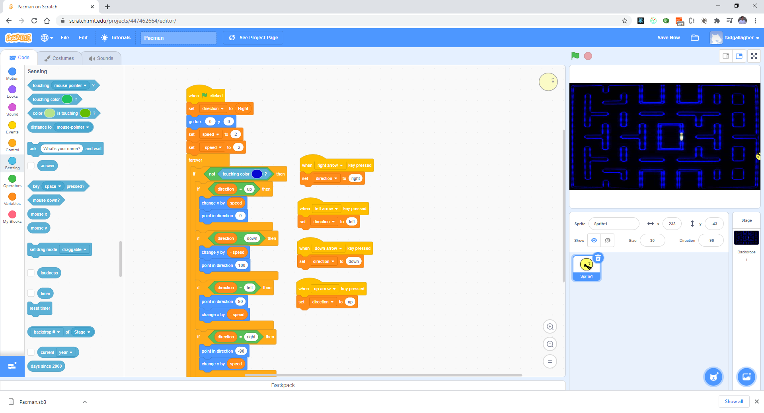
Not touching color

Slide 16
Test your work
Any issues?

Slide 17
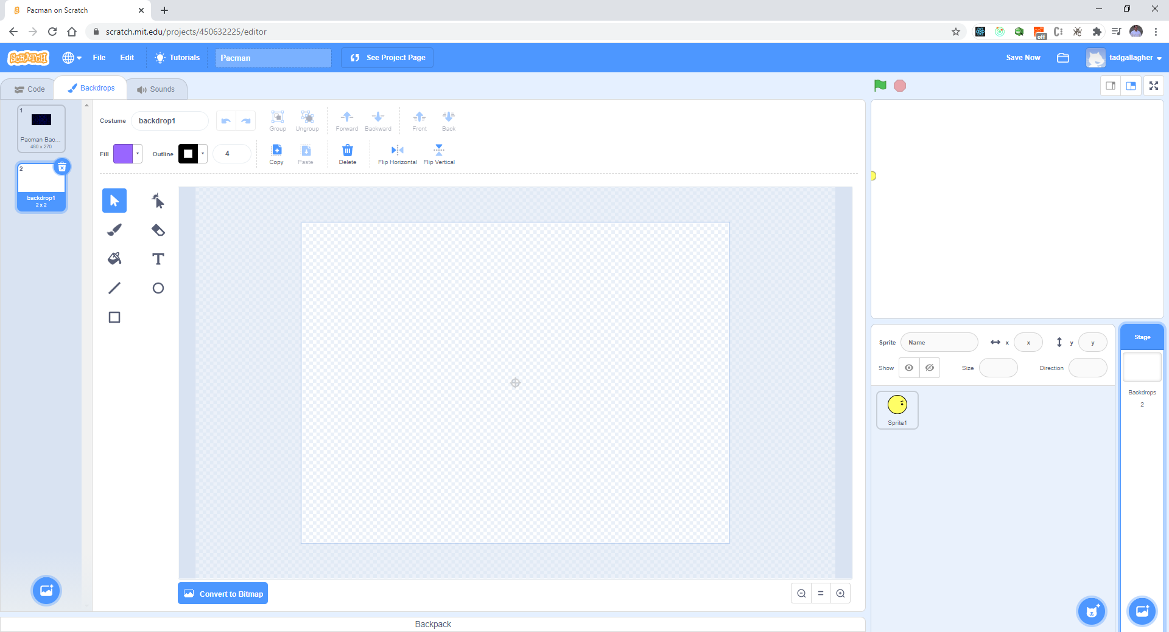
Temporarily change the background to a costume map – new background layer

Slide 18
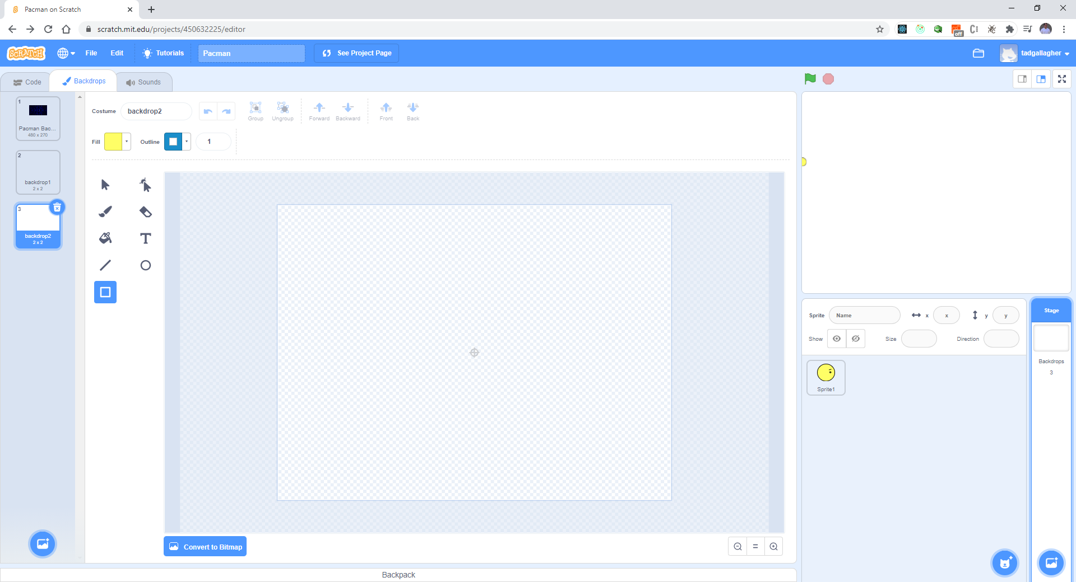
Add blue outline

Slide 19

Remove the Fill

Slide 20
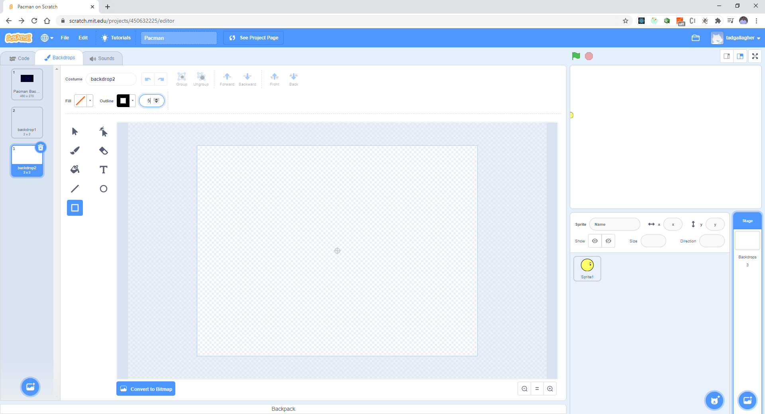
Make outline 5

Slide 21
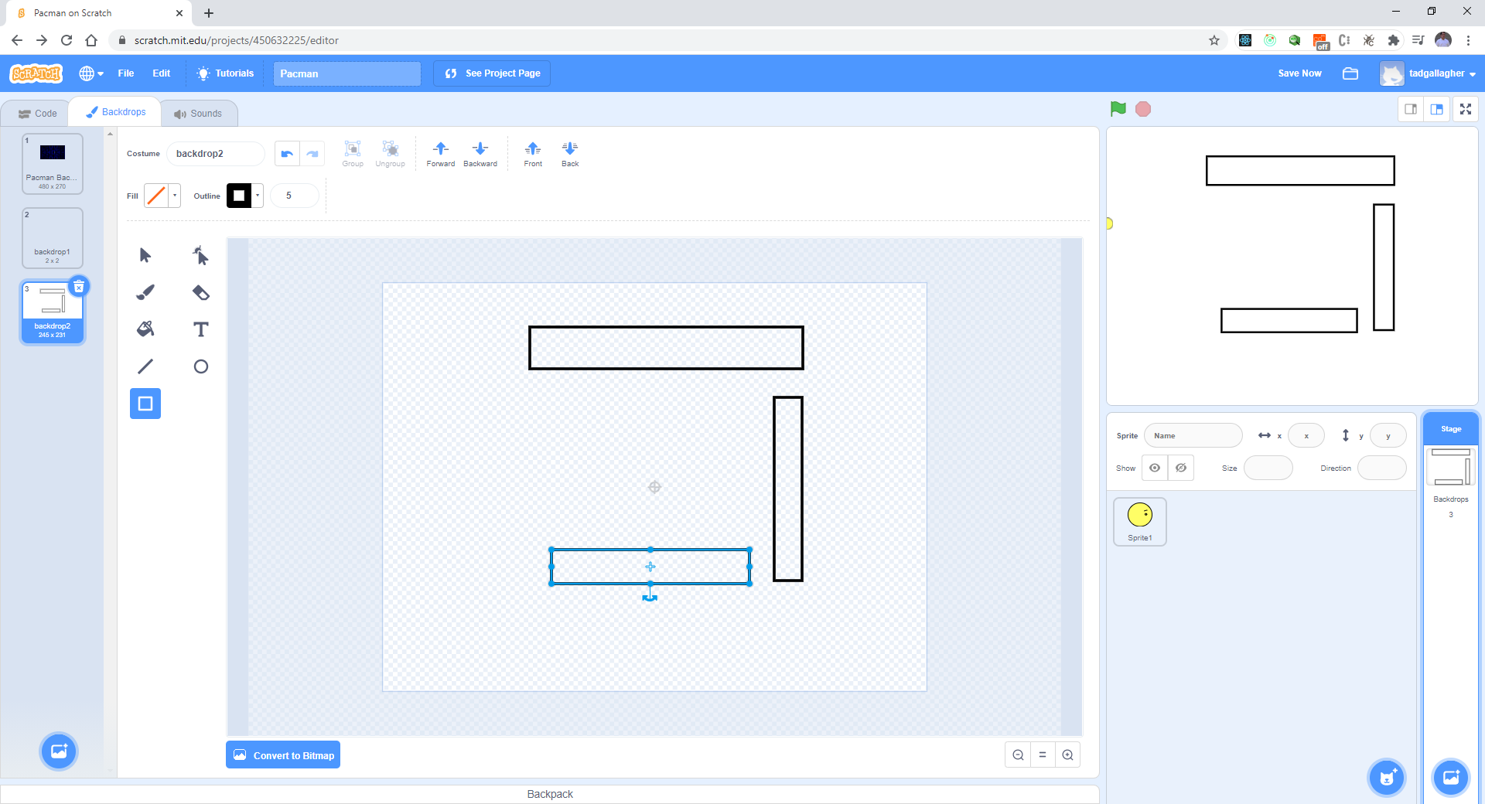
Draw some box for testing

Slide 22
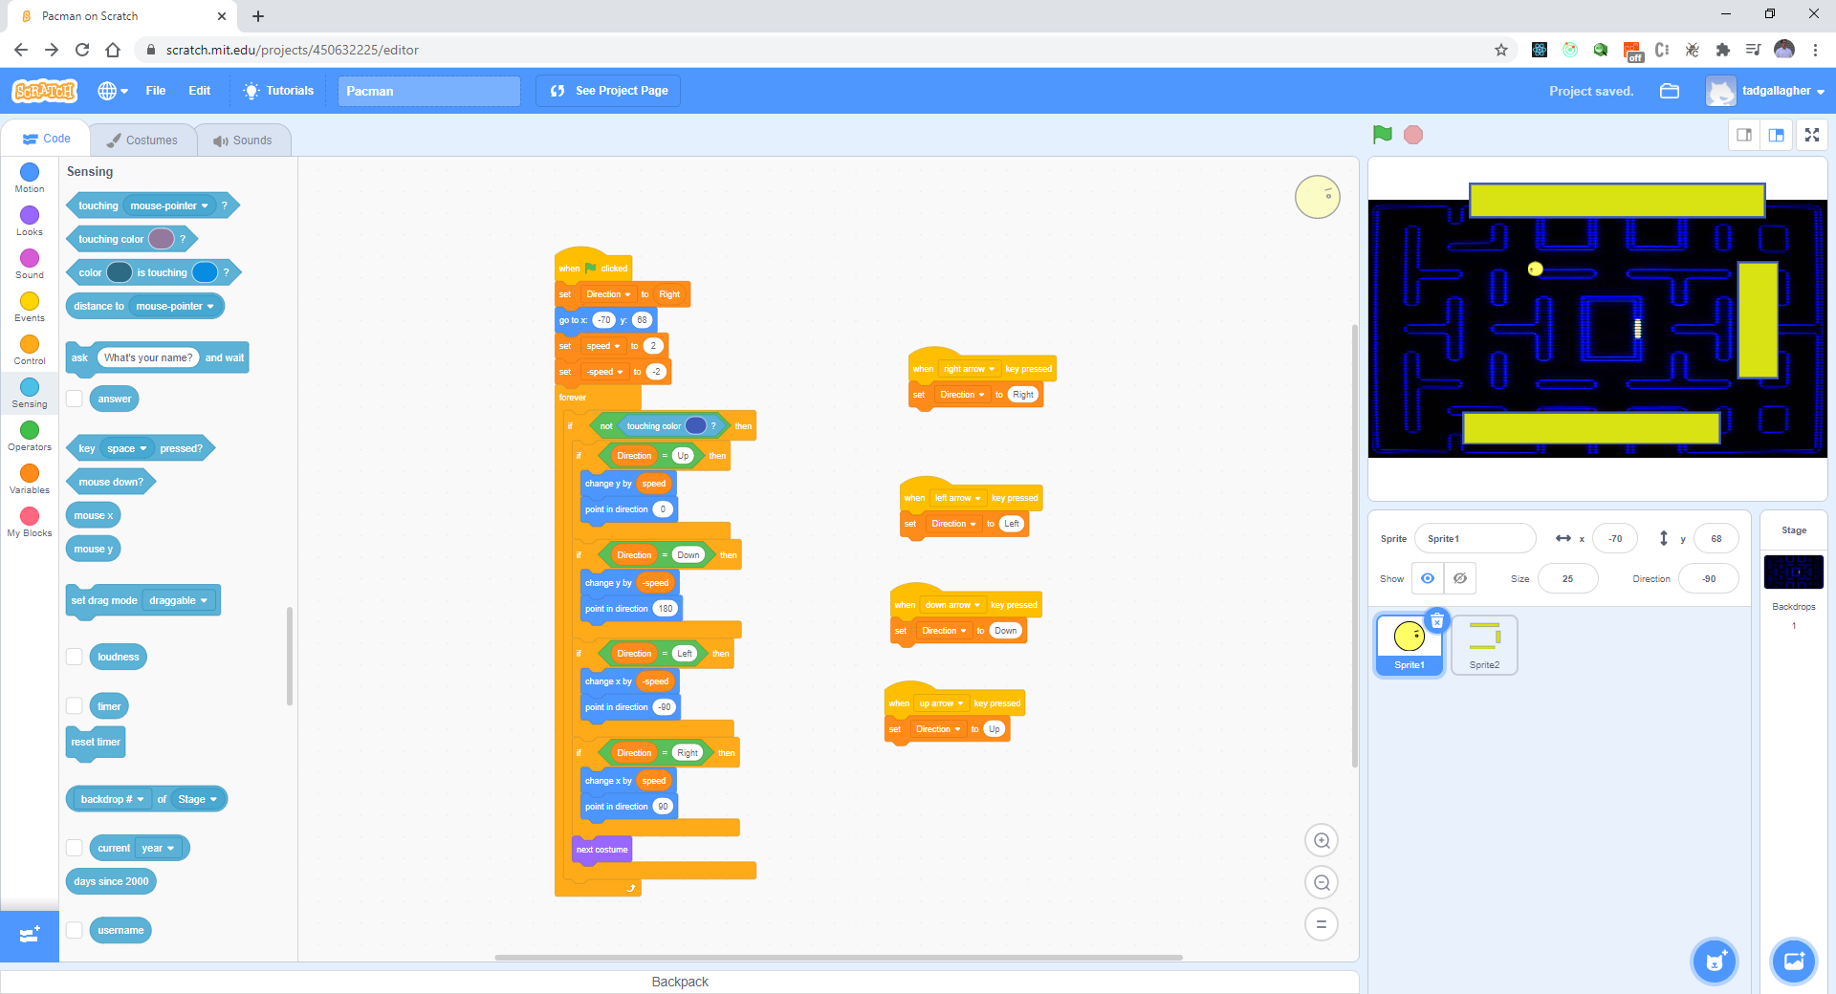
We are just trying the concept – should look like this:

Slide 23
Test your work
Is there a problem?
Doe it totally stop?

Slide 24
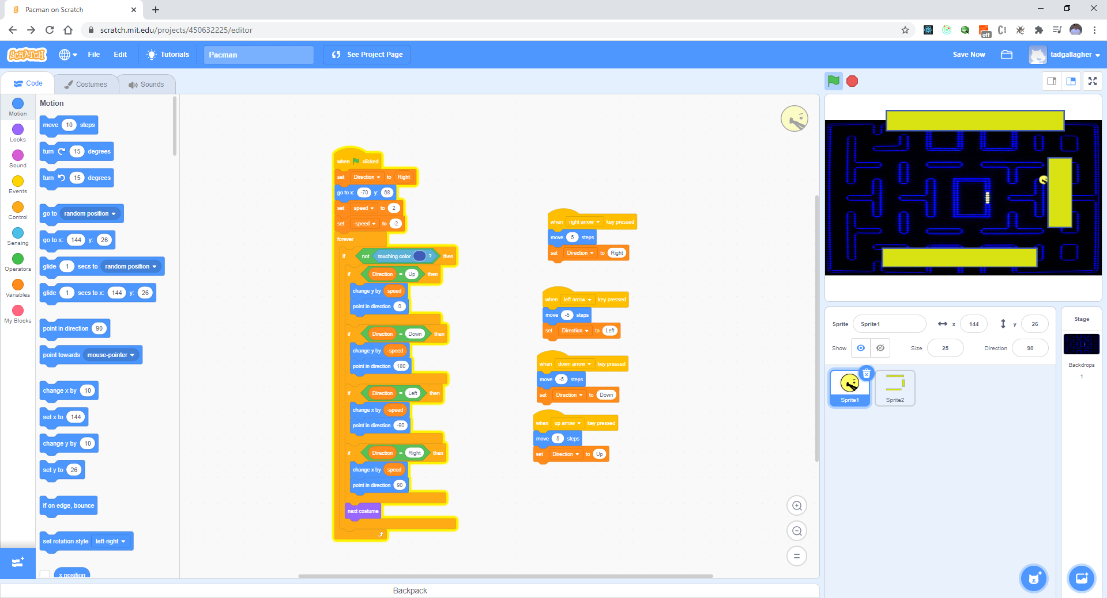
Need to fix the movement

Slide 25
Test your work
Any Issues?

Slide 26
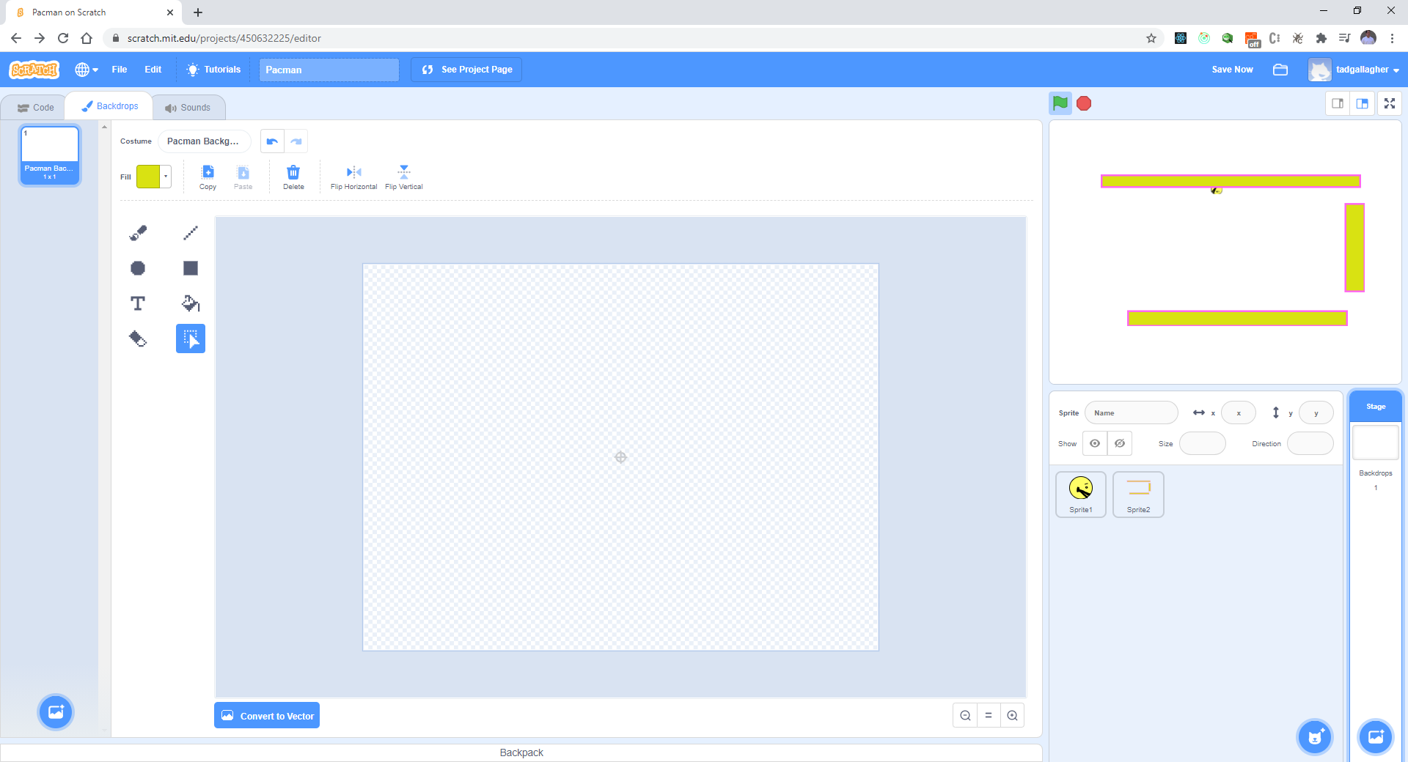
Delete old background

Slide 27
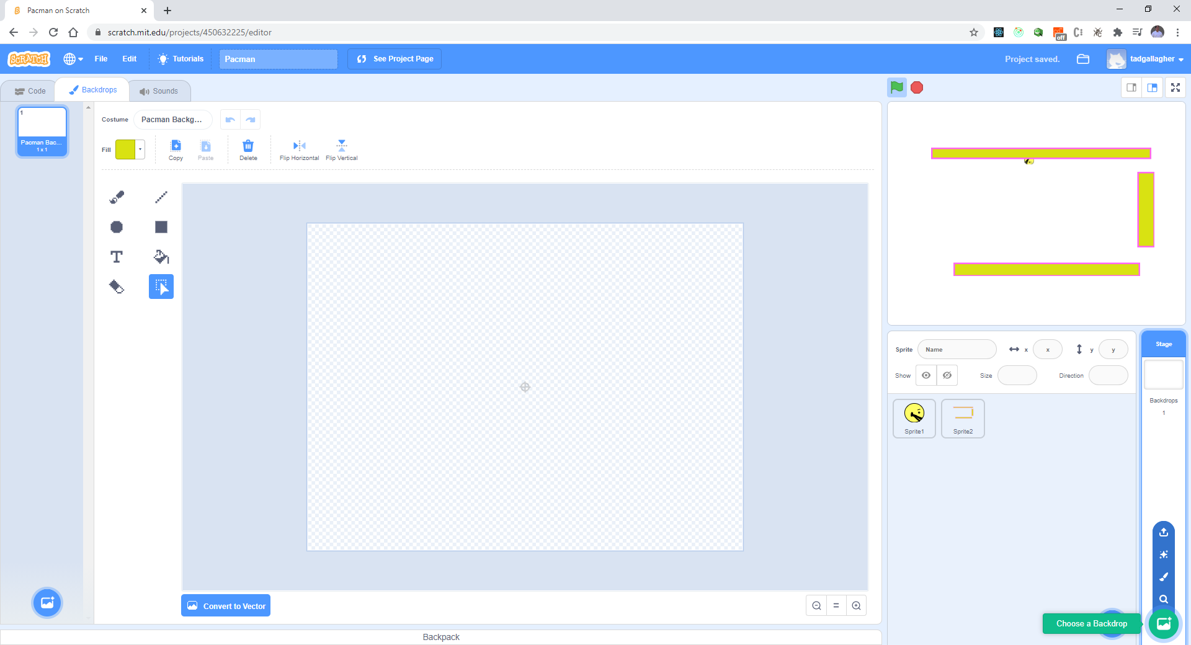
Change background to black

Slide 28
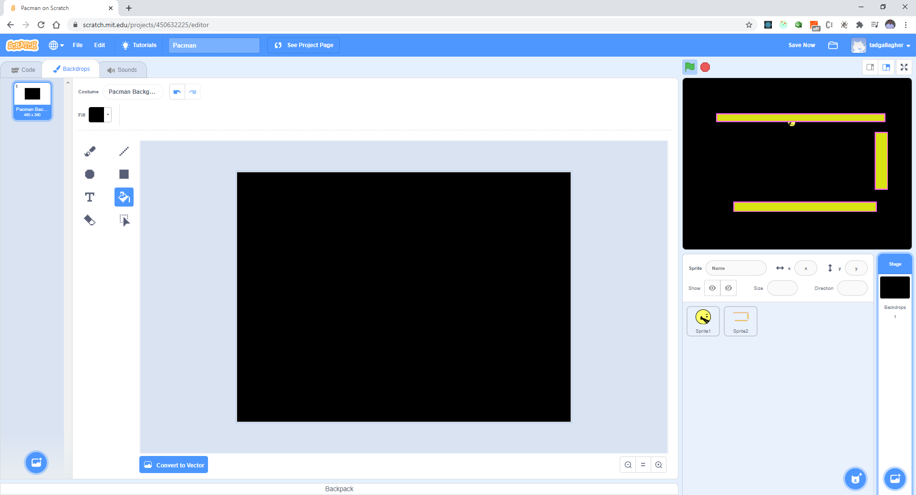
Black background

